Slide 1


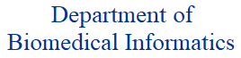
Clinical Decision Support
Shyam Visweswaran, MD, PhD
Professor of Biomedical Informatics
& Vice-Chair of Clinical Informatics
University of Pittsburgh
10-742: Machine Learning in Healthcare
3 October 2024

Slide 2
Applications of Artificial Intelligence (AI) in Medicine
For biomedical discovery
AI is used especially for big data, heterogeneous data, and combination of experimental and observational data
For clinical decision support (CDS)
CDS provides clinicians, patients or public health officials with knowledge and person-specific information, intelligently filtered or presented at appropriate times, to enhance health and health care¹
AI can make CDS more effective (AI-CDS)
¹Medicare and Medicaid Programs: Electronic Health Record Incentive Program. Vol 75 FR 44313; 4435, Washington DC, 2010, Centers for Medicare and Medicaid Services.

Slide 3
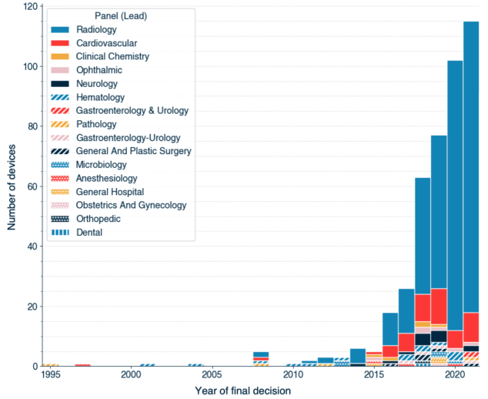
FDA approved AI Enabled Medical Devices
Holmes J, How smart is AI in healthcare? https://kinneirdufort.com/thinking/how-smart-is-ai-in-healthcare/

Slide 4
Outline
Need for AI-CDS
Evaluation of AI-CDS
Example AI-CDS projects
Algorithmic bias due to race

Slide 5
Need for AI-CDS

Slide 6
The Need for CDS: Clinical Challenges
Knowledge overload – Growing medical knowledge threatens to overwhelm human memory capacity (e.g., rise of molecular classification of disease is adding new rapidly changing medical knowledge)
Data overload – Increasing clinical data per patient threatens to overwhelm human cognitive ability to process (e.g., 1,400 new data points per patient per day in critical care)
Process overload – Rising length of time to review results or enter information in the electronic health record (EHR) system increases clinician burnout (e.g., 6 hours in a 11-hour day for documenting in the EHR system¹)
Visweswaran S, King AJ, Cooper GF. Integration of AI for Clinical Decision Support. In Cohen TA, Patel VL, Shortliffe EH (Eds): Intelligent Systems in Medicine and Health: The Role of AI. Springer; 2022.

Slide 7
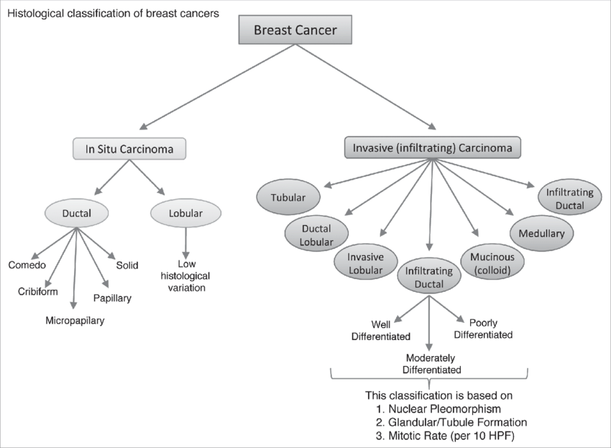
Histological Classification of Breast Cancers
Malhotra GK, Zhao X, Band H, Band V. Histological, molecular and functional subtypes of breast cancers. Cancer biology & therapy. 2010 Nov 15;10(10):955-60.

Slide 8
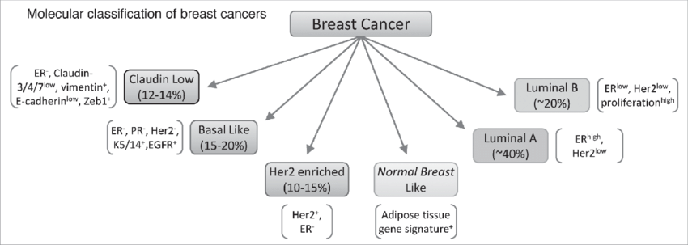
Molecular Classification of Breast Cancers
Malhotra GK, Zhao X, Band H, Band V. Histological, molecular and functional subtypes of breast cancers. Cancer biology & therapy. 2010 Nov 15;10(10):955-60.

Slide 9
The Need for CDS: Clinical Challenges
Knowledge overload – Growing medical knowledge threatens to overwhelm human memory capacity (e.g., rise of molecular classification of disease is adding new rapidly changing medical knowledge)
Data overload – Increasing clinical data per patient threatens to overwhelm human cognitive ability to process (e.g., 1,400 new data points per patient per day in critical care¹)
Process overload – Rising length of time to review results or enter information in the electronic health record (EHR) system increases clinician burnout (e.g., 6 hours in a 11-hour day for documenting in the EHR system¹)
¹Manor-Shulman O, Beyene J, Frndova H, Parshuram CS. Quantifying the volume of documented clinical information in critical illness. J Crit Care. 2008 Jun;23(2):245-50.

Slide 10
Limitations of Human Cognitive Capacity
1000
Proteomics and other
effector molecules
Facts per Decision
100
Functional Genetics:
e.g. gene expression profiles
10
Structural Genetics:
e.g. mutations
Decisions by clinical phenotype i.e., traditional health care
Human Cognitive Capacity
1990
2000
2010
2020
William Stead, IOM Meeting, October 8, 2007. Growth in factors affecting provider decisions versus human cognitive capacity.

Slide 11
The Need for CDS: Clinical Challenges
Knowledge overload – Growing medical knowledge threatens to overwhelm human memory capacity (e.g., rise of molecular classification of disease is adding new rapidly changing medical knowledge)
Data overload – Increasing clinical data per patient threatens to overwhelm human cognitive ability to process (e.g., 1,400 new data points per patient per day in critical care)
Process overload – Rising length of time to review results or enter information in the electronic health record (EHR) system increases clinician burnout (e.g., 6 hours in a 11-hour day for documenting in the EHR system¹)
¹Arndt BG, Beasley JW, Watkinson MD, Temte JL, Tuan WJ, Sinsky CA, Gilchrist VJ. Tethered to the EHR: primary care physician workload assessment using EHR event log data and time-motion observations. Ann Fam Med. 2017 Sep;15(5):419-426.

Slide 12
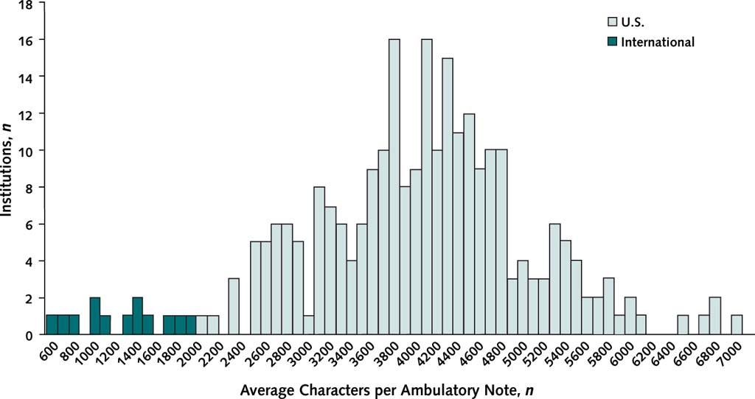
Increasing Clinical Documentation
Downing NL, Bates DW, Longhurst CA. Physician burnout in the electronic health record era: are we ignoring the real cause? Annals of internal medicine. 2018 Jul 3;169(1):50-1.
Notes:
Average characters per ambulatory progress note in U.S. and international health systems.
Column height represents number of organizations. Dark columns represent 13 organizations outside the United States (140 000 notes from Canada, the United Kingdom, Australia, the Netherlands, Denmark, the United Arab Emirates, and Singapore). Light columns represent 254 organizations in the United States (10 million notes).

Slide 13
Evaluation of AI-CDS

Slide 14
Example of AI-CDS Deployment With Minimal Evaluation
Epic Sepsis Model is implemented at hundreds of U.S. hospitals to predict who will develop sepsis
Evaluation study done after deployment:
Showed poor discrimination and calibration
Area under ROC curve of 0.63 (95% CI, 0.62-0.64)
Missed 67% of sepsis patients though had heavy alert burden (alerts on 18% of patients)
Wong A, Otles E, Donnelly JP, Krumm A, McCullough J, DeTroyer-Cooley O, et al. External validation of a widely implemented proprietary sepsis prediction model in hospitalized patients. JAMA Intern Med. 2021 Aug 1;181(8):1065–70.

Slide 15

Evaluation Framework for a New Biologic
Study Phase | Vaccine
T0: Basic research | Pre-clinical in-vitro and animal studies
T1: Translation to humans | Phase I: Study in a small number healthy people to assess safety
T2: Translation to patients | Phase II: Study in a moderate number of at-risk people to assess efficacy
T3: Translation to practice | Phase III: Trial (often RCT) in a large population to verify safety and efficacy; approval by FDA
T4: Translation to communities | Phase IV: Post-deployment studies to monitor safety and efficacy
Waldman SA, Terzic A. Clinical and translational science: from bench-bedside to global village. Clin Transl Sci. 2010 Oct;3(5):254-7.

Slide 16
Evaluation Framework for a New AI-CDS
Study Phase | Vaccine | AI-CDS
T0: Basic research | Pre-clinical in-vitro and animal studies | Pre-clinical AI modeling and tool development
T1: Translation to humans | Phase I: Study in a small number healthy people to assess safety | Study in laboratory with retrospective patients with actual users to assess safety
T2: Translation to patients | Phase II: Study in a moderate number of at-risk people to assess efficacy | Study in hospital or clinic on real patients with actual users to assess performance
T3: Translation to practice | Phase III: Trial (often RCT) in a large population to verify safety and efficacy; approval by FDA | Trial in multiple hospitals or clinics to verify safety and performance; approval by FDA
T4: Translation to communities | Phase IV: Post-deployment studies to monitor safety and efficacy | Post-deployment studies to monitor safety (e.g., bias) and performance (e.g., drift)

Slide 17
Example AI-CDS Projects

Slide 18
AI-CDS Types Based on Response Time
In seconds
In minutes
In days / weeks

Slide 19
Example AI-CDS Projects
In seconds
In minutes
In days / weeks
Monitoring intraoperative cerebral ischemia
Predicting post-induction hypotension
Identifying relevant patient data in the ICU
Anomaly detection in ICU decision-making
Predicting opioid dependence in the outpatient clinic
Predicting risk of bleeding on direct anticoagulants

Slide 20
Monitoring Intraoperative Cerebral Ischemia Using Electroencephalography (EEG)

Slide 21
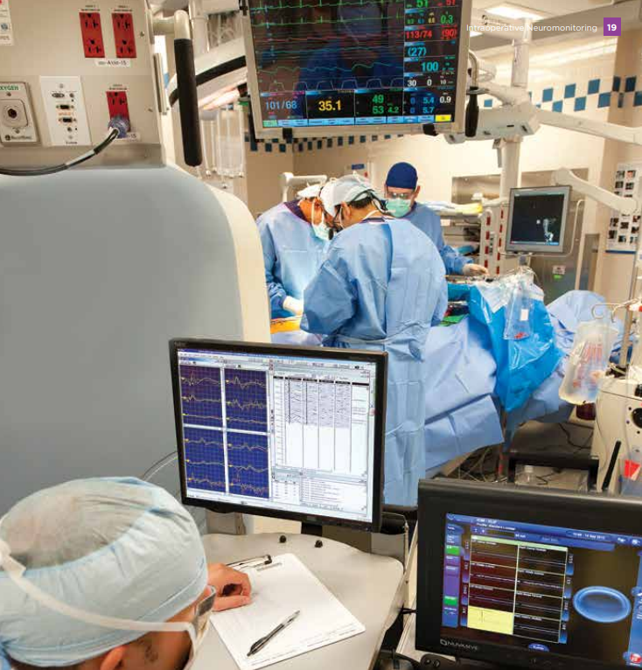

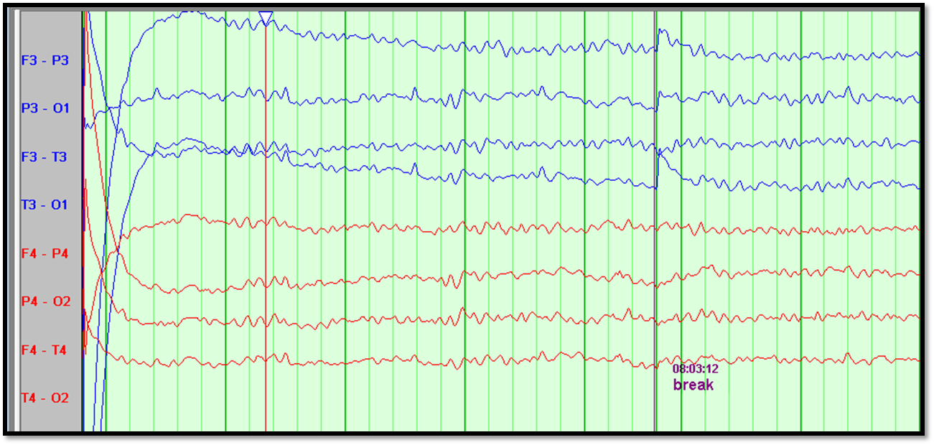
Intraoperative EEG-based Ischemia Monitoring

Slide 22
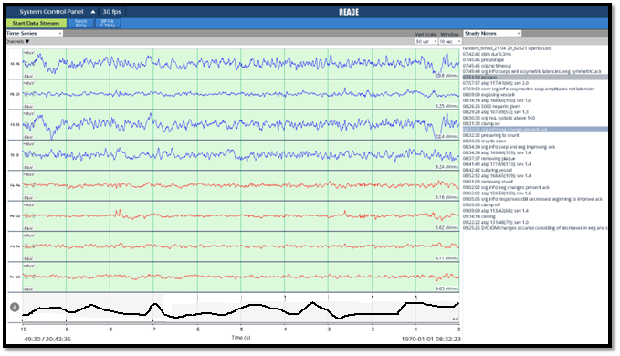
AI-Based Monitoring
probability of ischemia

Slide 23
Annotated Data
No ischemia throughout
Monitoring start
Monitoring end
ischemia
Monitoring start
Monitoring end

Slide 24
Developmental Pipeline
Raw Data
(1544 cases)
EEG data + annotations by domain experts
process
Processed Data
(1544 cases)
Training Data
(782 cases)
AI algorithms
Test Data
(762 cases)
Models
Performance
AUROC, AUPRC sensitivity specificity

Slide 25
Model Performance
Model | AUROC | Sensitivity | Specificity
Random Forest | 0.80 | 0.52 | 0.92
LightGBM (Light Gradient Boosting Machine) | 0.80 | 0.35 | 0.98
XGBRF (eXtreme Gradient Boosting with Random Forest) | 0.80 | 0.32 | 0.98
The 3 best performing models all achieved AUROC of 0.80
Random Forest overall is the best with high specificity (0.92) and moderate sensitivity (0.52)

Slide 26
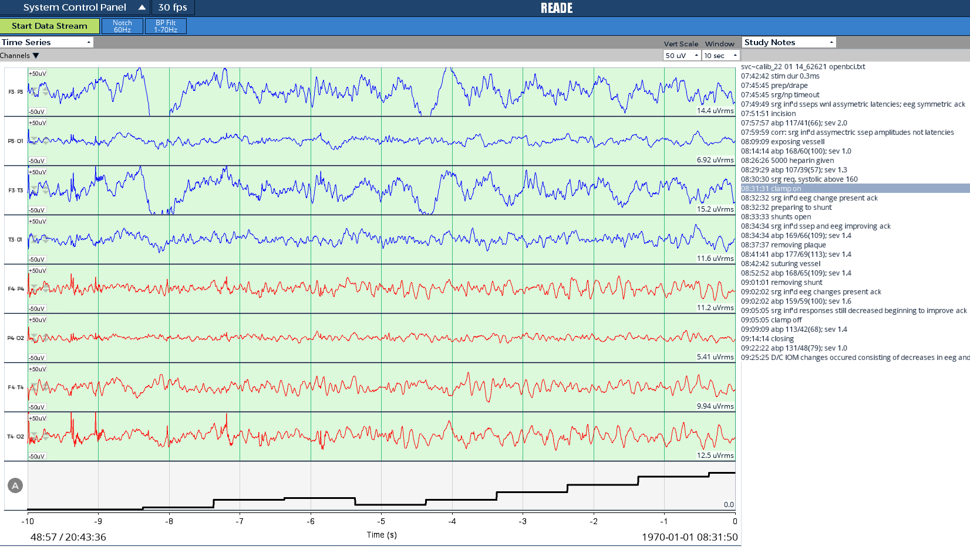
Application of Random Forest

Slide 27



Envisioned Data Flow for Monitoring Study
Operating room
Neurophysiologist’s office
Vendor system
Vendor system
CDS
Obtain EEG signal data every second
Preprocess EEG signal data
Apply model
Send output

Slide 28
A Learning Electronic Medical Record (LEMR) System for Identifying Relevant Patient Data

Slide 29
Learning Electronic Medical Record System (LEMR)
Electronic medical record (EMR) system that
observes how physicians access patient data in the EMR
and uses that information to improve future display of data in the EMR
Goal of a LEMR system is to draw the physician’s attention to the right data of the right patient at the right time
King AJ, Cooper GF, Hochheiser H, Clermont G, Visweswaran S. Development and preliminary evaluation of a prototype of a Learning Electronic Medical Record System. AMIA Annu Symp Proc. 2015 Nov 5;2015:1967-75.

Slide 30
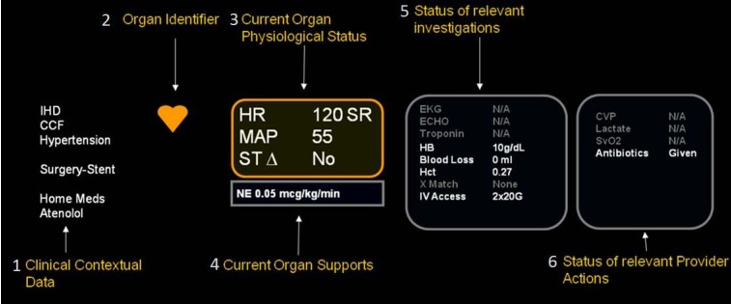
Rule-Based Approach: AWARE
Data relevant to patient condition is highlighted in bold
Pickering BW, Herasevich V, Ahmed A, Gajic O. Novel Representation of Clinical Information in the ICU: Developing User Interfaces which Reduce Information Overload. Appl Clin Inform. 2010 Apr 28;1(2):116-31.

Slide 31
Alternative: Data-Driven Approach
EMR that displays the data that a physician wants to view for the current patient case
Wants to view is something that we can learn to predict with AI models
The training data is the data in the EMR that many physicians viewed for many different patient cases – that we call patient data access patterns

Slide 32



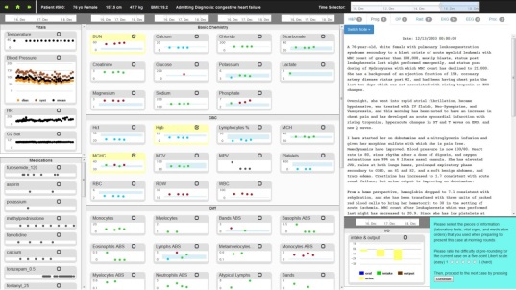


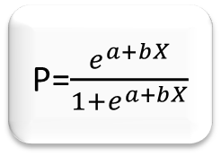
Alternative: Data-Driven Approach
P=$\frac{e^{a+bX}}{1+e^{a+bX}}$
Train
Apply
Collect patient data access patterns
Models
Predict data physician wants to view

Slide 33
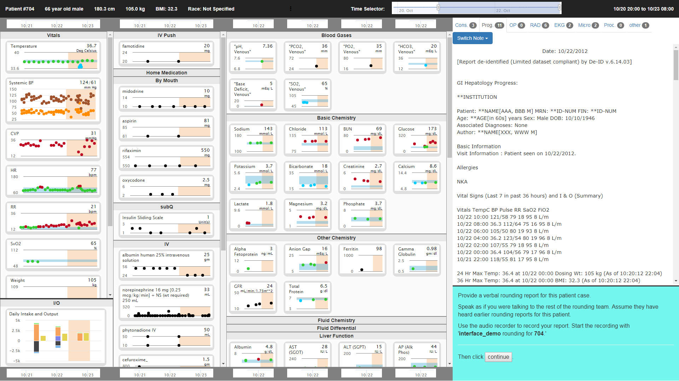
LEMR Display

Slide 34
LEMR Display
Demographics
Time range currently displayed across all data fields
Vitals and vent settings
Medications
(grouped
by route)
Laboratory test results
(grouped by type)
Free text data:
Notes, reports, & procedures
(grouped by tabs)
ICU Admission
Current time
Slide to change displayed range
Your tasks and navigation
Intake/output

Slide 35
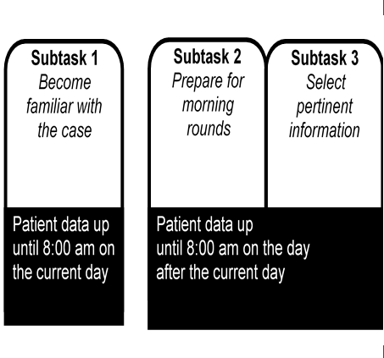
Obtaining Training Labels

Slide 36
Before Selection of Targets

Slide 37
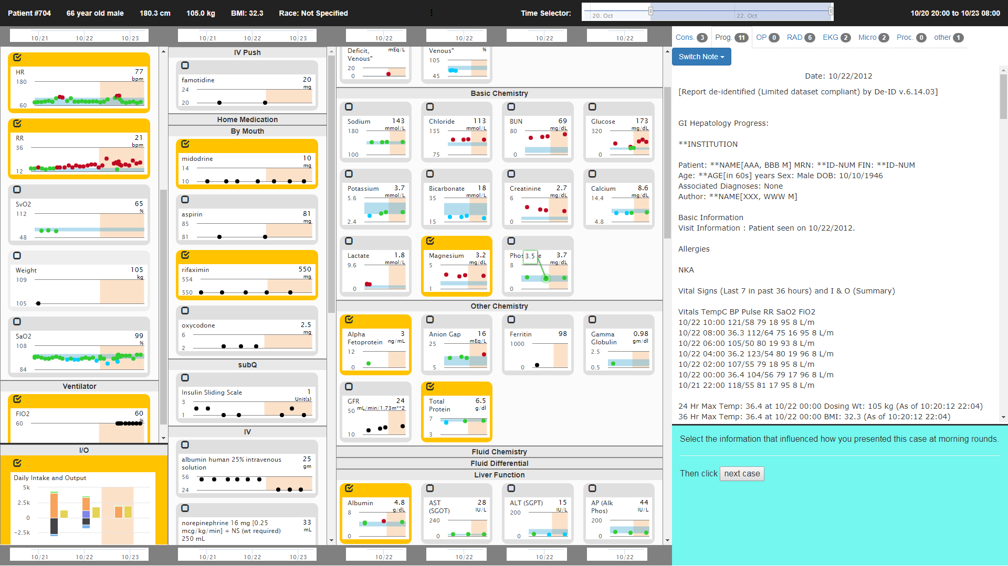
After Selection of Targets

Slide 38
Training Data
Data on many patients with corresponding data access patterns (targets) constitute the training data
Obtained from EMR
patient data
data access patterns (targets)
Diagnoses
Diagnosis | cirrhosis
Age | 47
Sex | female
BUN | 39
Hemoglobin | 10.1
SGPT | 107
SGOT | 48
Bili, Total | 1.4
Metoprolol | 200
…
1
0
0
1
1
1
1
0
0
…
Diagnosis | GI medical
Age | 27
Sex | male
BUN | 21
pHa | 7.32
Hematocrit | 55
INR | 1.1
PT | 12.7
Haloperidol | 2.5
…
1
0
0
1
1
1
0
0
0
…
Collected from physician labelers
Demographics
Diagnosis | Trauma
Age | 49
Sex | female
Sodium | 140
Calcium | 7.8
Magnesium | 1.7
RBC | 2.43
WBC | 6
Platelets | 418
…
1
0
0
1
0
0
1
0
1
…
Diagnosis | CABG
Age | 62
Sex | male
Sodium | 138
Potassium | 5.5
Hemoglobin | 16
RBC | 5.34
INR | 1
IV heparin | 1000
…
1
0
0
1
1
0
0
1
1
…
Diagnosis | Valve surg.
Age | 77
Sex | male
Phosphate | 14
Sodium | 135
Potassium | 12
PT | 14.2
PO2 | 70
Mg dose | 2
…
0
1
1
1
1
1
0
0
0
…
Diagnosis | GI medical
Age | 71
Sex | female
Glucose | 89
PTT | 43
Potassium | 3.8
SGPT | 17
SGOT | 18
IV Heparin | 0
…
1
1
0
0
1
0
0
0
1
…
Diagnosis | Hepatic fail.
Age | 46
Sex | male
BUN | 48
RDW | 13.5
WBC | 5.9
INR | 2.6
PT | 28.4
n-acetylcysteine | 6.65
…
1
0
0
1
0
0
1
1
1
…
Diagnosis | CABG
Age | 54
Sex | male
BUN | 14
GFR | 135
Creatinine | 0.8
Hemoglobin | 7.0
Glucose | 285
Insulin dose | 8
…
0
1
0
0
0
0
1
1
1
…
Lab test results
Medications
Vital signs
Procedures
etc.
Mr. Benton
Dr. B
Mrs. Kern
Dr. B
Mr. Carroll
Dr. B
Mr. Lewis
Dr. A
Mrs. Ross
Dr. C
Mr. Smith
Dr. C
Mr. Stark
Dr. A

Slide 39
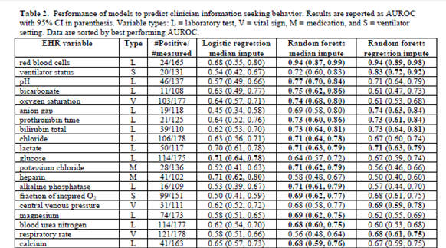
AUROCs of Models

Slide 40
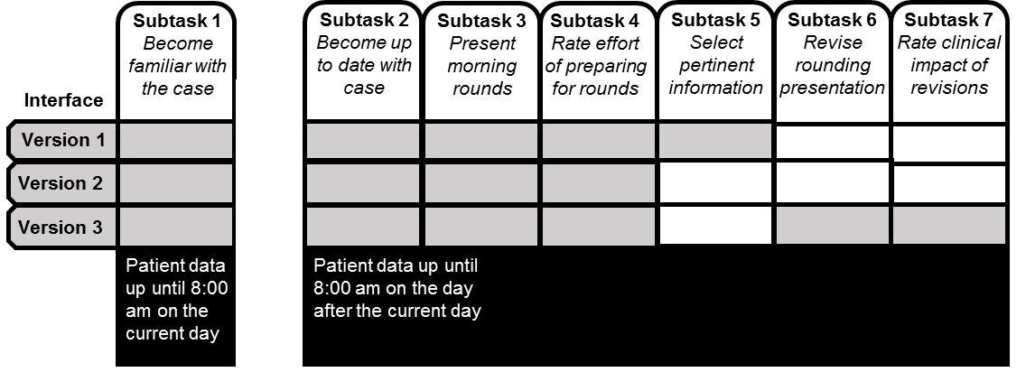
Evaluation Protocol
12 ICU fellows perform a case review task for 18 patient cases
Each fellow uses three interface versions
Version 1: Display all information, with none highlighted (6 cases)
Version 2: Display highlighted information and show all other information (6 cases)
Version 3: Only display highlighted information (6 cases)
Key evaluation measures
Time to task completion
Precision and recall of highlighted information, relative to clinician selection of information as the gold standard

Slide 41
Time to Task Completion
Arm | Mean time to task completion (sec) | Standard deviation
1 No highlights | 140.4 | 76.9
2 With highlights | 146.4 | 75.3
3 Only highlights | 114.9 | 65.3
King AJ, Cooper GF, Clermont G, Hochheiser H, Hauskrecht M, Sittig DF, Visweswaran S. Using machine learning to selectively highlight patient information. Journal of Biomedical Informatics. 2019 Oct; 29:103327.

Slide 42
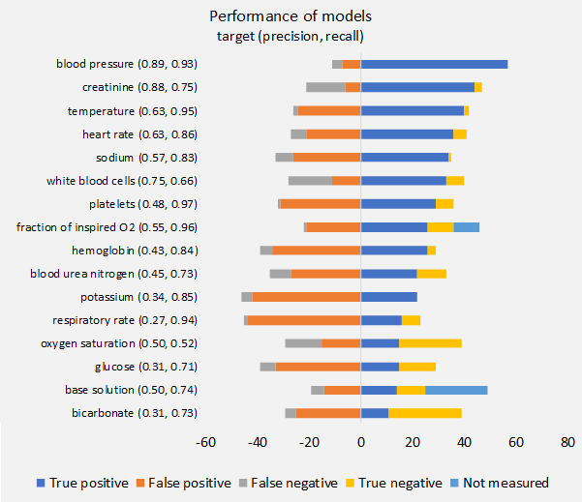
Model Performance

Slide 43
Conclusions
The prototype Learning EMR (LEMR) system learns how to predict data that a physician is likely to view
Results show that the models have promising performance
Results show that when less data is shown, the time to task completion decreases
Limitation: More data is needed to train more models and to have better performance

Slide 44
Envisioned Data Flow for LEMR Study
ICU
Data center
Cerner system
Cerner display
CDS
Obtain ICU EHR data every minute
Preprocess EHR data
Apply model
Send output

Slide 45
Machine-Learning Prediction and Reducing Overdoses with EHR Nudges (mPROVEN)

Slide 46
mPROVEN
PI: Walid Gellad, MD, MPH (Department of Medicine, University of Pittsburgh)
Opioid overdose risk prediction models developed using EHR data
Currently implementing CDS for Epic using Neptune, our research data warehouse

Slide 47
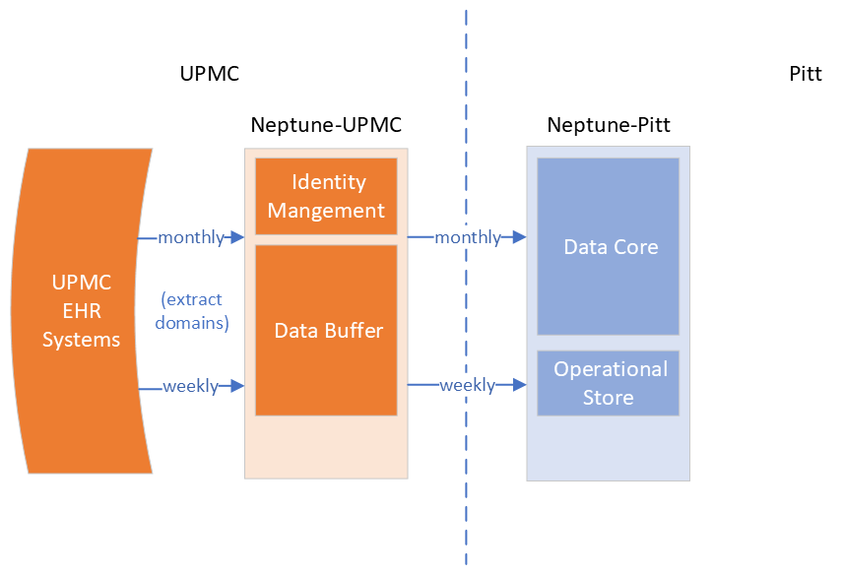
Research Data Warehouse

Slide 48
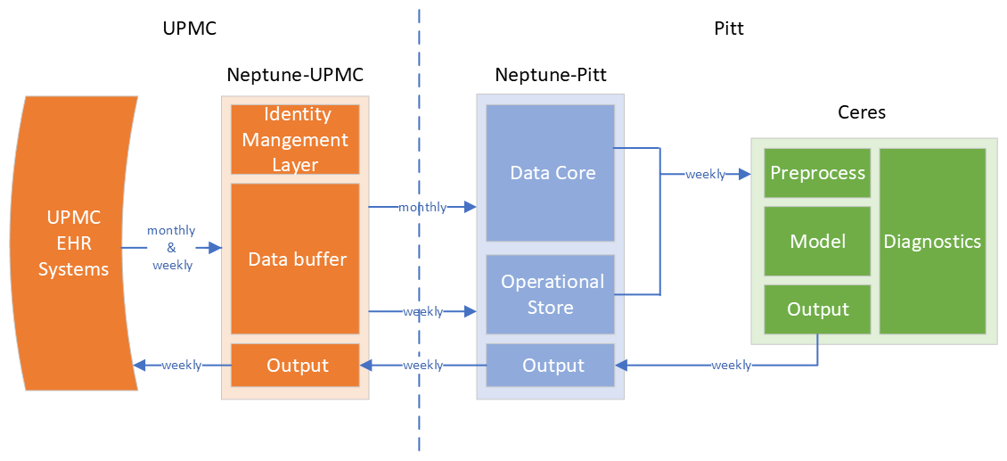
Research Data Warehouse with CDS

Slide 49
Some Take-Aways
Implementation of AI-CDS is a very different task compared to model development
New software must be developed for preprocessing, model application and output verification
Implementation differs based on CDS response time (seconds, minutes, days)
Ideally, AI-CDS software should be implemented outside the EHR system especially during the research stage

Slide 50
Algorithmic Bias Due to Race

Slide 51
Example of AI-CDS with Racial Bias
Commercial algorithm used in 200M patients per year in the U.S. to predict health risk score
Evaluation study done after deployment:
Underrated the severity of Black patients’ health conditions relative to their white counterparts
Led to under-provisioning of health care to Black patients
Problem:
Model was developed to predict future healthcare cost as a proxy for health risk
Healthcare cost reflects inequities in healthcare access
Obermeyer Z, Powers B, Vogeli C, Mullainathan S. Dissecting racial bias in an algorithm used to manage the health of populations. Science. 2019 Oct 25;366(6464):447–53.

Slide 52
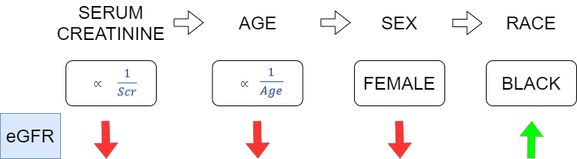
Clinical Calculator with Race
Estimated glomerular filtration (eGFR)
Increasing serum creatinine, increasing age, and female sex decrease eGFR, while black race increases eGFR
Compared to the white race, the equation estimates that a member of the Black race has 16% better eGFR
Leads to Black patients waiting longer and becoming sicker before getting treatment

Slide 53
Catalog of Clinical Calculators with Race
Category | Description | Number of calculators
risk calculator | differential risk of a clinical event is predicted based on race | 39
laboratory test | differential laboratory test reference ranges are recommended based on race | 6
therapy recommendation | differential therapy is recommended based on race | 1
See https://www.clinical-algorithms-with-race.org/
Visweswaran S, Sadhu EM, Morris MM, Samayamuthu MJ. Clinical algorithms with race: an online database. medRxiv. 2023. doi: https://doi.org/10.1101/2023.07.04.23292231.

Slide 54
UTICalc
UTICalc Version 1
Logistic regression model that predicts the risk of UTI in febrile children 2 years of age or younger from five binary demographic and clinical predictors including
age (<12 months vs ≥2 months)
sex (female or uncircumcised male vs circumcised male)
race (black vs nonblack)
fever (<39°C vs ≥39°C)
alternate fever source (no other source of fever vs other source of fever)
Shaikh N, Morone NE, Bost JE, Farrell MH. Prevalence of urinary tract infection in childhood: a meta-analysis. Pediatr Infect Dis J. 2008 Apr;27(4):302-8.

Slide 55
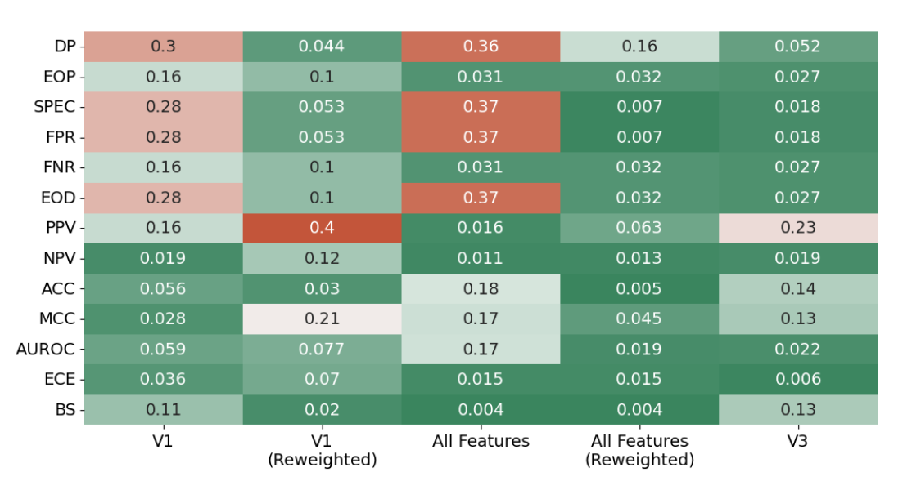
Improving Fairness in UTICalc
Anderson JW, Shaikh N, Visweswaran S. Measuring and reducing racial bias in a pediatric urinary tract infection model. medRxiv [Preprint]. 2023 Sep 18:2023.09.18.23295660.

Slide 56
Acknowledgements
Collaborators
Andrew J. King, PhD
Amir I. Mina, MD/PhD trainee
Gregory F. Cooper, MD, PhD
Harry Hochheiser, PhD
Gilles Clermont, MD, MSc
Milos Hauskrecht, PhD
Parthasarathy Thirumala, MD
Kayhan Batmanghelich, PhD
Jessi U. Espino, MD, MS
Joshua W. Anderson, MS
Nader Shaikh, MD, MPH
Funding
R01 LM012095 Development and Evaluation of a Learning Electronic Medical Record System
UPMC Enterprises Realtime Evaluation for Adverse Events using Intraoperative Neurophysiological Monitoring (READE IONM)
R01 EB032752 Learning Alerting Models for Clinical Care from EMR Data and Human Knowledge
UL1 TR001857 University of Pittsburgh Clinical and Translational Science Institute
U24 TR004111 ENACT: Translating Health Informatics Tools to Research and Clinical Decision Making

Slide 57

Shyam Visweswaran, MD, PhD
shv3@pitt.edu
www.ccai.thevislab.com
[commons.wikipedia.com]

